Slide 1


AgriSphere
Smart farming guidance in every farmer's pocket
Vumani Dlamini
Tshegofatso Thapedi
Mahlatse Phatlane
Daniel Balepe
Divin Mathemwana
Gift Lekgothoane
Team FusionX

Slide 2
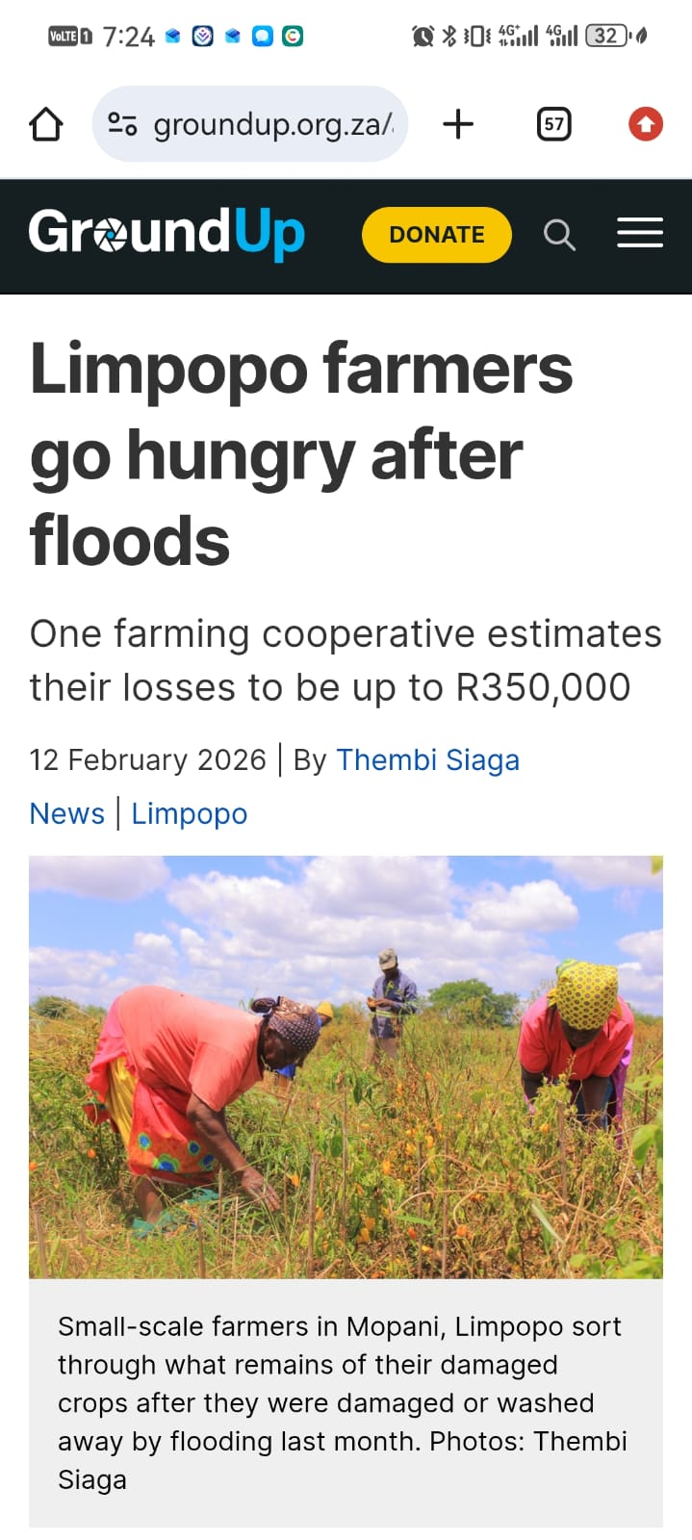
Problem
Late Detection
Diseases discovered too
Late.
Loss of Profit
Cost Barrier
Professional advice too expensive.
Loss of Crops
C
Environmental Factors
Guesswork Watering
Temperature, moisture,
humidity, and drought.

Slide 3




Solution
So the question is… what if every farmer had access to a smart,
affordable agronomist in their pocket?
Our solution works in three powerful layers:
AI Vision
Detects crop diseases using smartphone
camera.
Smart Sensors (IOT)
Monitors soil and environmental conditions in real time
Predictive Intelligence
Uses AI to recommend actions and predict yields
Together, this gives farmers real-time, data-driven decisions without needing expensive experts.

Slide 4
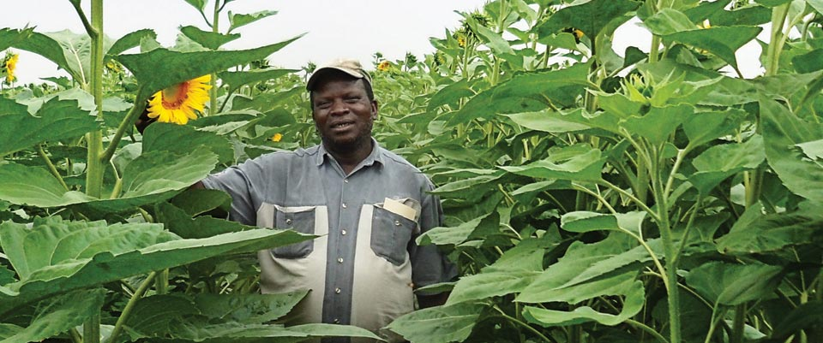
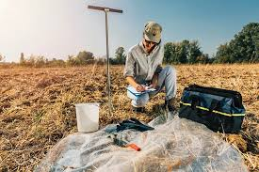
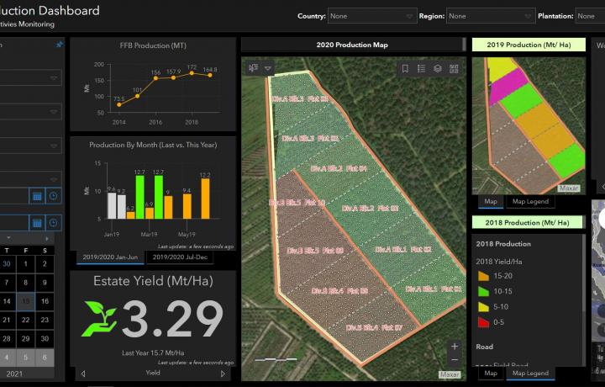
Competitors
A professional farming consulting company
Farmers Agri-Care -
They:
Work mainly with commercial farmers
Provide expert advice
Use data + research
Help improve yields through human expertise + tools

Slide 5
Competitors
Feature | Farmers Agri-Care | AgriSphere
Access | Physical / consultants | Mobile app 📱
Cost | Expensive | Affordable (R49)
Availability | Limited hours | 24/7 AI ⏰
Target Market | Commercial farmers | Smallholder farmers 👨🏾‍🌾
Location | Mostly KZN | Rural + anywhere 🌍
Internet | Required systems | Works offline ⚡
Speed | Slow consultations | Instant responses 🚀

Slide 6


Business Model
Tiered Subscriptions
Agronomist Network
Future Revenue Streams
Starting at R49/month for premium AI features like deep disease analysis and yield prediction
R99 one-time registration fee creates a verified expert network connecting farmers with professionals
IoT device sales
Data insights for agri-businesses
Government & NGO partnerships
15%
30%
30%
Yield Increase
Maximum Gain
Maximum Gain
AI-driven precision agriculture
Research from East African farms
Research from East African farms

Slide 7
Conclusion
Unlike Farmers Agri-Care, which relies on physical agronomists and is primarily accessible to commercial farmers, AgriSphere is designed for smallholder farmers, offering instant, affordable, and AI-powered farming support directly from a mobile device, even in low-connectivity areas.
We are not competing with agronomists, we are scaling them.

